Slide 1
Short read alignment
Fan, Changxu
Ting Wang lab. Dept. Genetics
Program of Immunology

Slide 2
Scope:
Key topic:
Mappability in the context of pair-end reads
Assay types:
Mainly ATAC-seq alignment
Touch upon RNA-seq alignment and Hi-C alignment
Software:
Mainly centered on bowtie2 in end-to-end mode
Touch upon STAR and bwa
Species:
Mainly aligning C57BL/6J mouse DNA to mm10 reference

Slide 3
Code availability
Github for small demos
Large datasets: location on our server is provided.
All of my R code are arranged as packages under: /bar/cfan/R_packages/. For example, function ‘cageFanc::tagdust()’ can be found under: /bar/cfan/R_packages/cageFanc/R/, and can be called after installing the package with command ‘R CMD INSTALL cageFanc’

Slide 4
Basic tools (besides WashU browser):
Samtools: view alignments on the terminal
IGV: visualize variation from the reference
Bioconductor: Rsamtools, GenomicRanges and GenomicAlignements

Slide 5
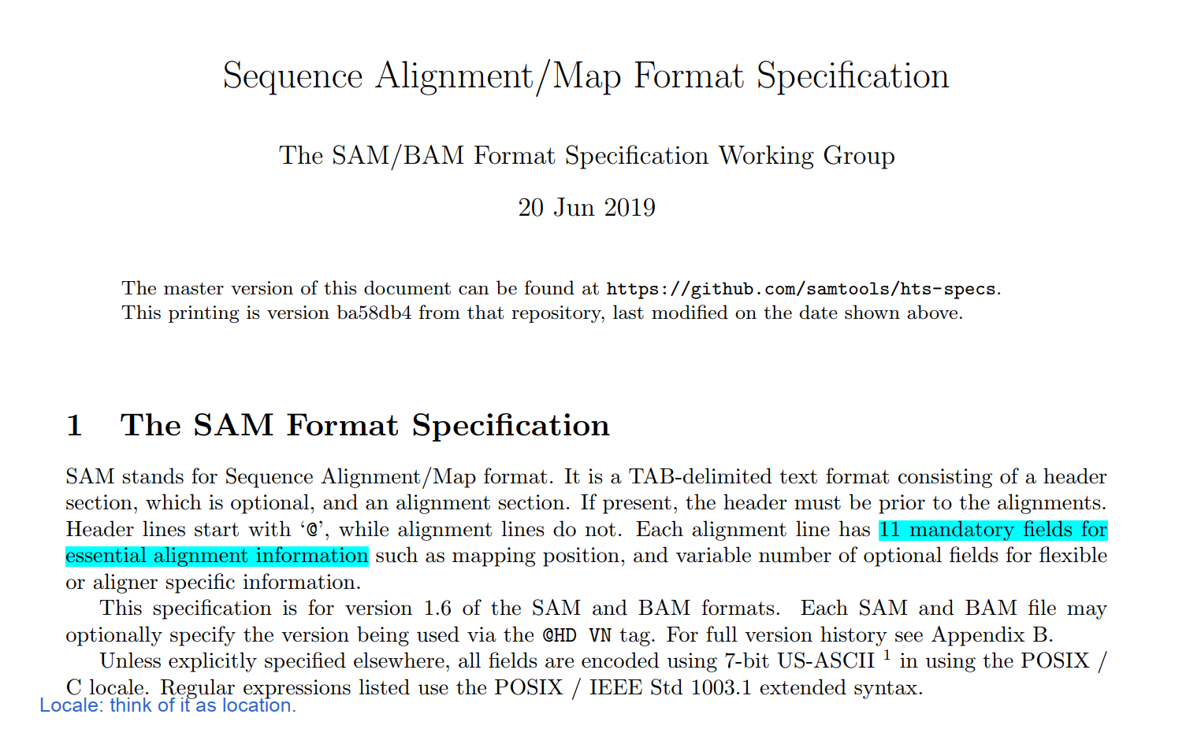
The absolute basics:
Docs/SAMv1.pdf

Slide 6
Before alignment:
clean up the reads
Remove adaptors -> remove low quality reads -> remove reads that are too short

Slide 7
Before alignment:
clean up the reads
Remove adaptors -> remove low quality reads -> remove reads that are too short
know your reference
Type 1: reads are from the exact reference
Align DNA reads from C57BL/6J mouse strain to the mm10/m39 genome
Align DNA reads from HPRC samples to their personal genomes
Type 2: reads are from the same species, but not the same individual as the reference
Align DNA reads from human samples to hg38/hg19
Remove alternative chromosomes before alignment

Slide 8
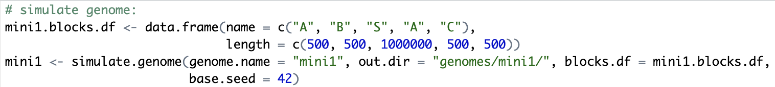
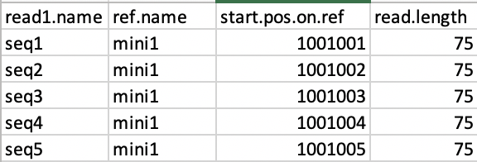
Example 1: single end alignment (simulated)
example_1.R
Simulate genome:
Simulate reads:
500 bp
1M bp
A
B
Spacer
A
C

Slide 9
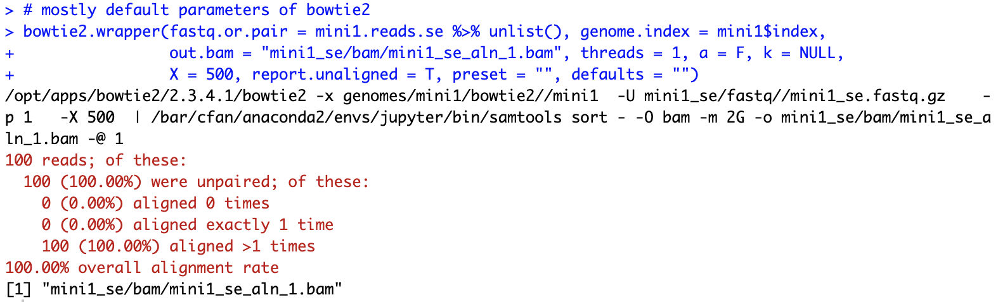
Alignment using bowtie2 (mostly default parameters)

Slide 10
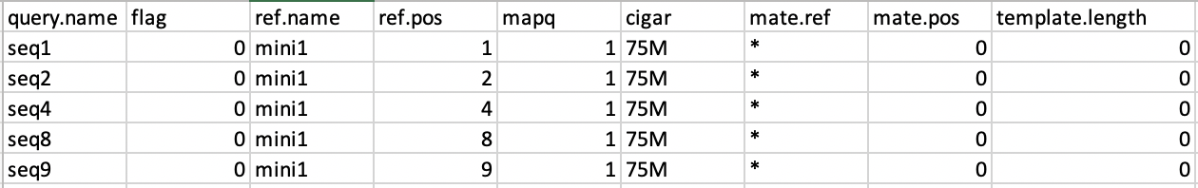
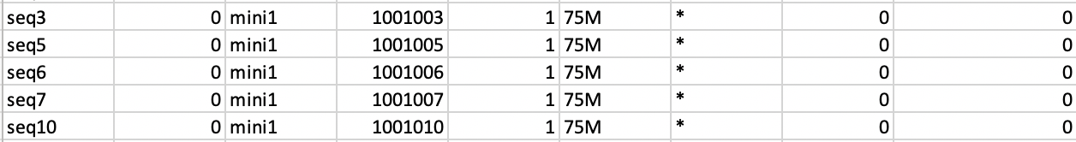
Alignment results
500 bp
1M bp
A
B
Spacer
A
C
Aligner properties:
Each read only reported once
Multimapping reads assigned randomly
Mapq is 1 (not 0!!) for “True” multimapping reads

Slide 11
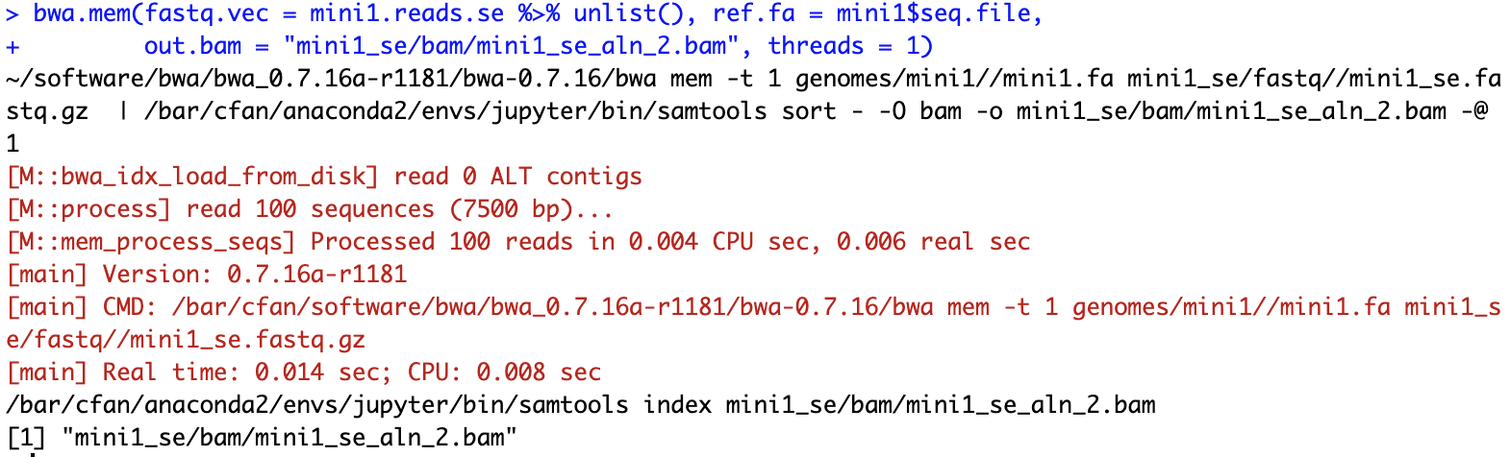
Align using bwa

Slide 12
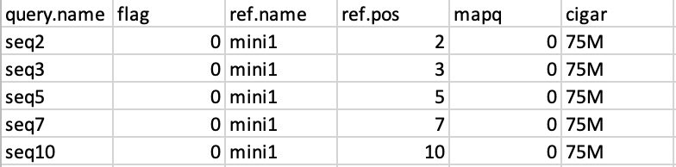
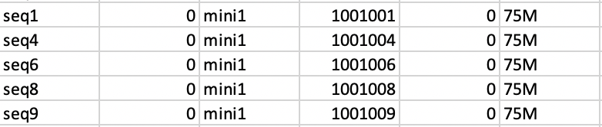
Alignment results
500 bp
1M bp
A
B
Spacer
A
C
Aligner properties:
Each read only reported once
Multimapping reads assigned randomly
Mapq is 0 for “True” multimapping reads

Slide 13
MAPQ: rarely calculated as defined
MAPQ’s definition:
How mapq is really calculated: in whatever way the aligner feels comfortable
https://sequencing.qcfail.com/articles/mapq-values-are-really-useful-but-their-implementation-is-a-mess/

Slide 14
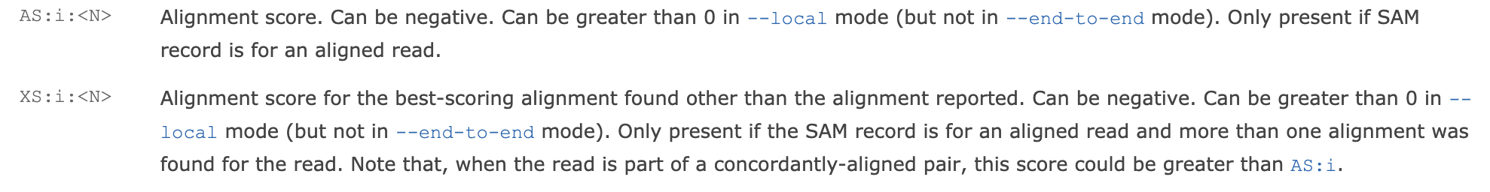
MAPQ in bowtie2:
Calculated based on alignment score
A
B
C
Alignment 1 (1 mismatch)
Alignment 2 (0 mismatch)
AS = -6, XS = 0
AS = 0, XS = -6
Secondary alignment
Primary alignment (best match)
Intuitively, bowtie2 compares the best alignment score (AS) vs the 2nd best alignment score (XS)

Slide 15
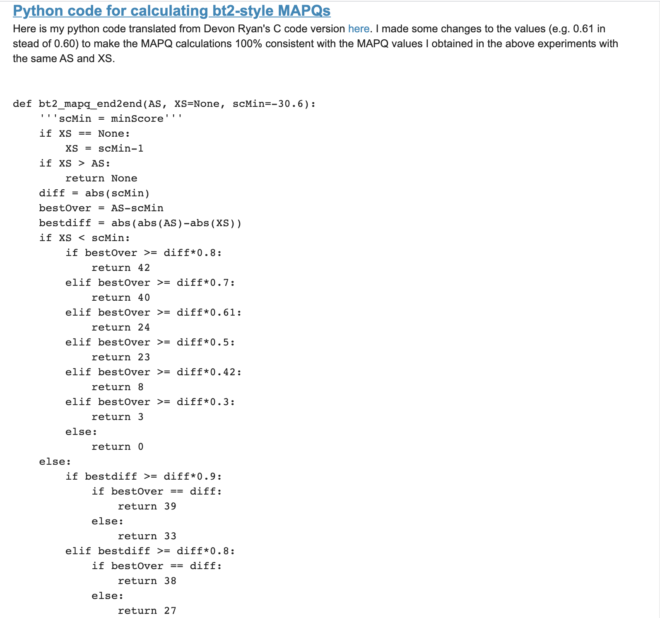
http://biofinysics.blogspot.com/2014/05/how-does-bowtie2-assign-mapq-scores.html

Slide 16
Bowtie2’s algorithm for calculating MAPQ
Larger difference between AS and XS -> higher MAPQ
Higher AS -> better MAPQ
The highest possible MAPQ is 42
The lowest possible MAPQ:
A read maps equally well to 2 places -> MAPQ = 1
A read maps equally badly to 2 places -> MAPQ = 0
MAPQ 255: carries special meanings

Slide 17
Bowtie2 MAPQ = 255?
Default mode: highest possible mapq is 42
Primary
alignment
-k or -a mode: mapq of unique alignment could be 255
A read
In bowtie2 version 2.3.4.1: share the same mapq as primary alignment
Secondary
alignment(s)
In bowtie2 version 2.4.2: mapq = 255
PLEASE NOTE: the version of the aligner

Slide 18
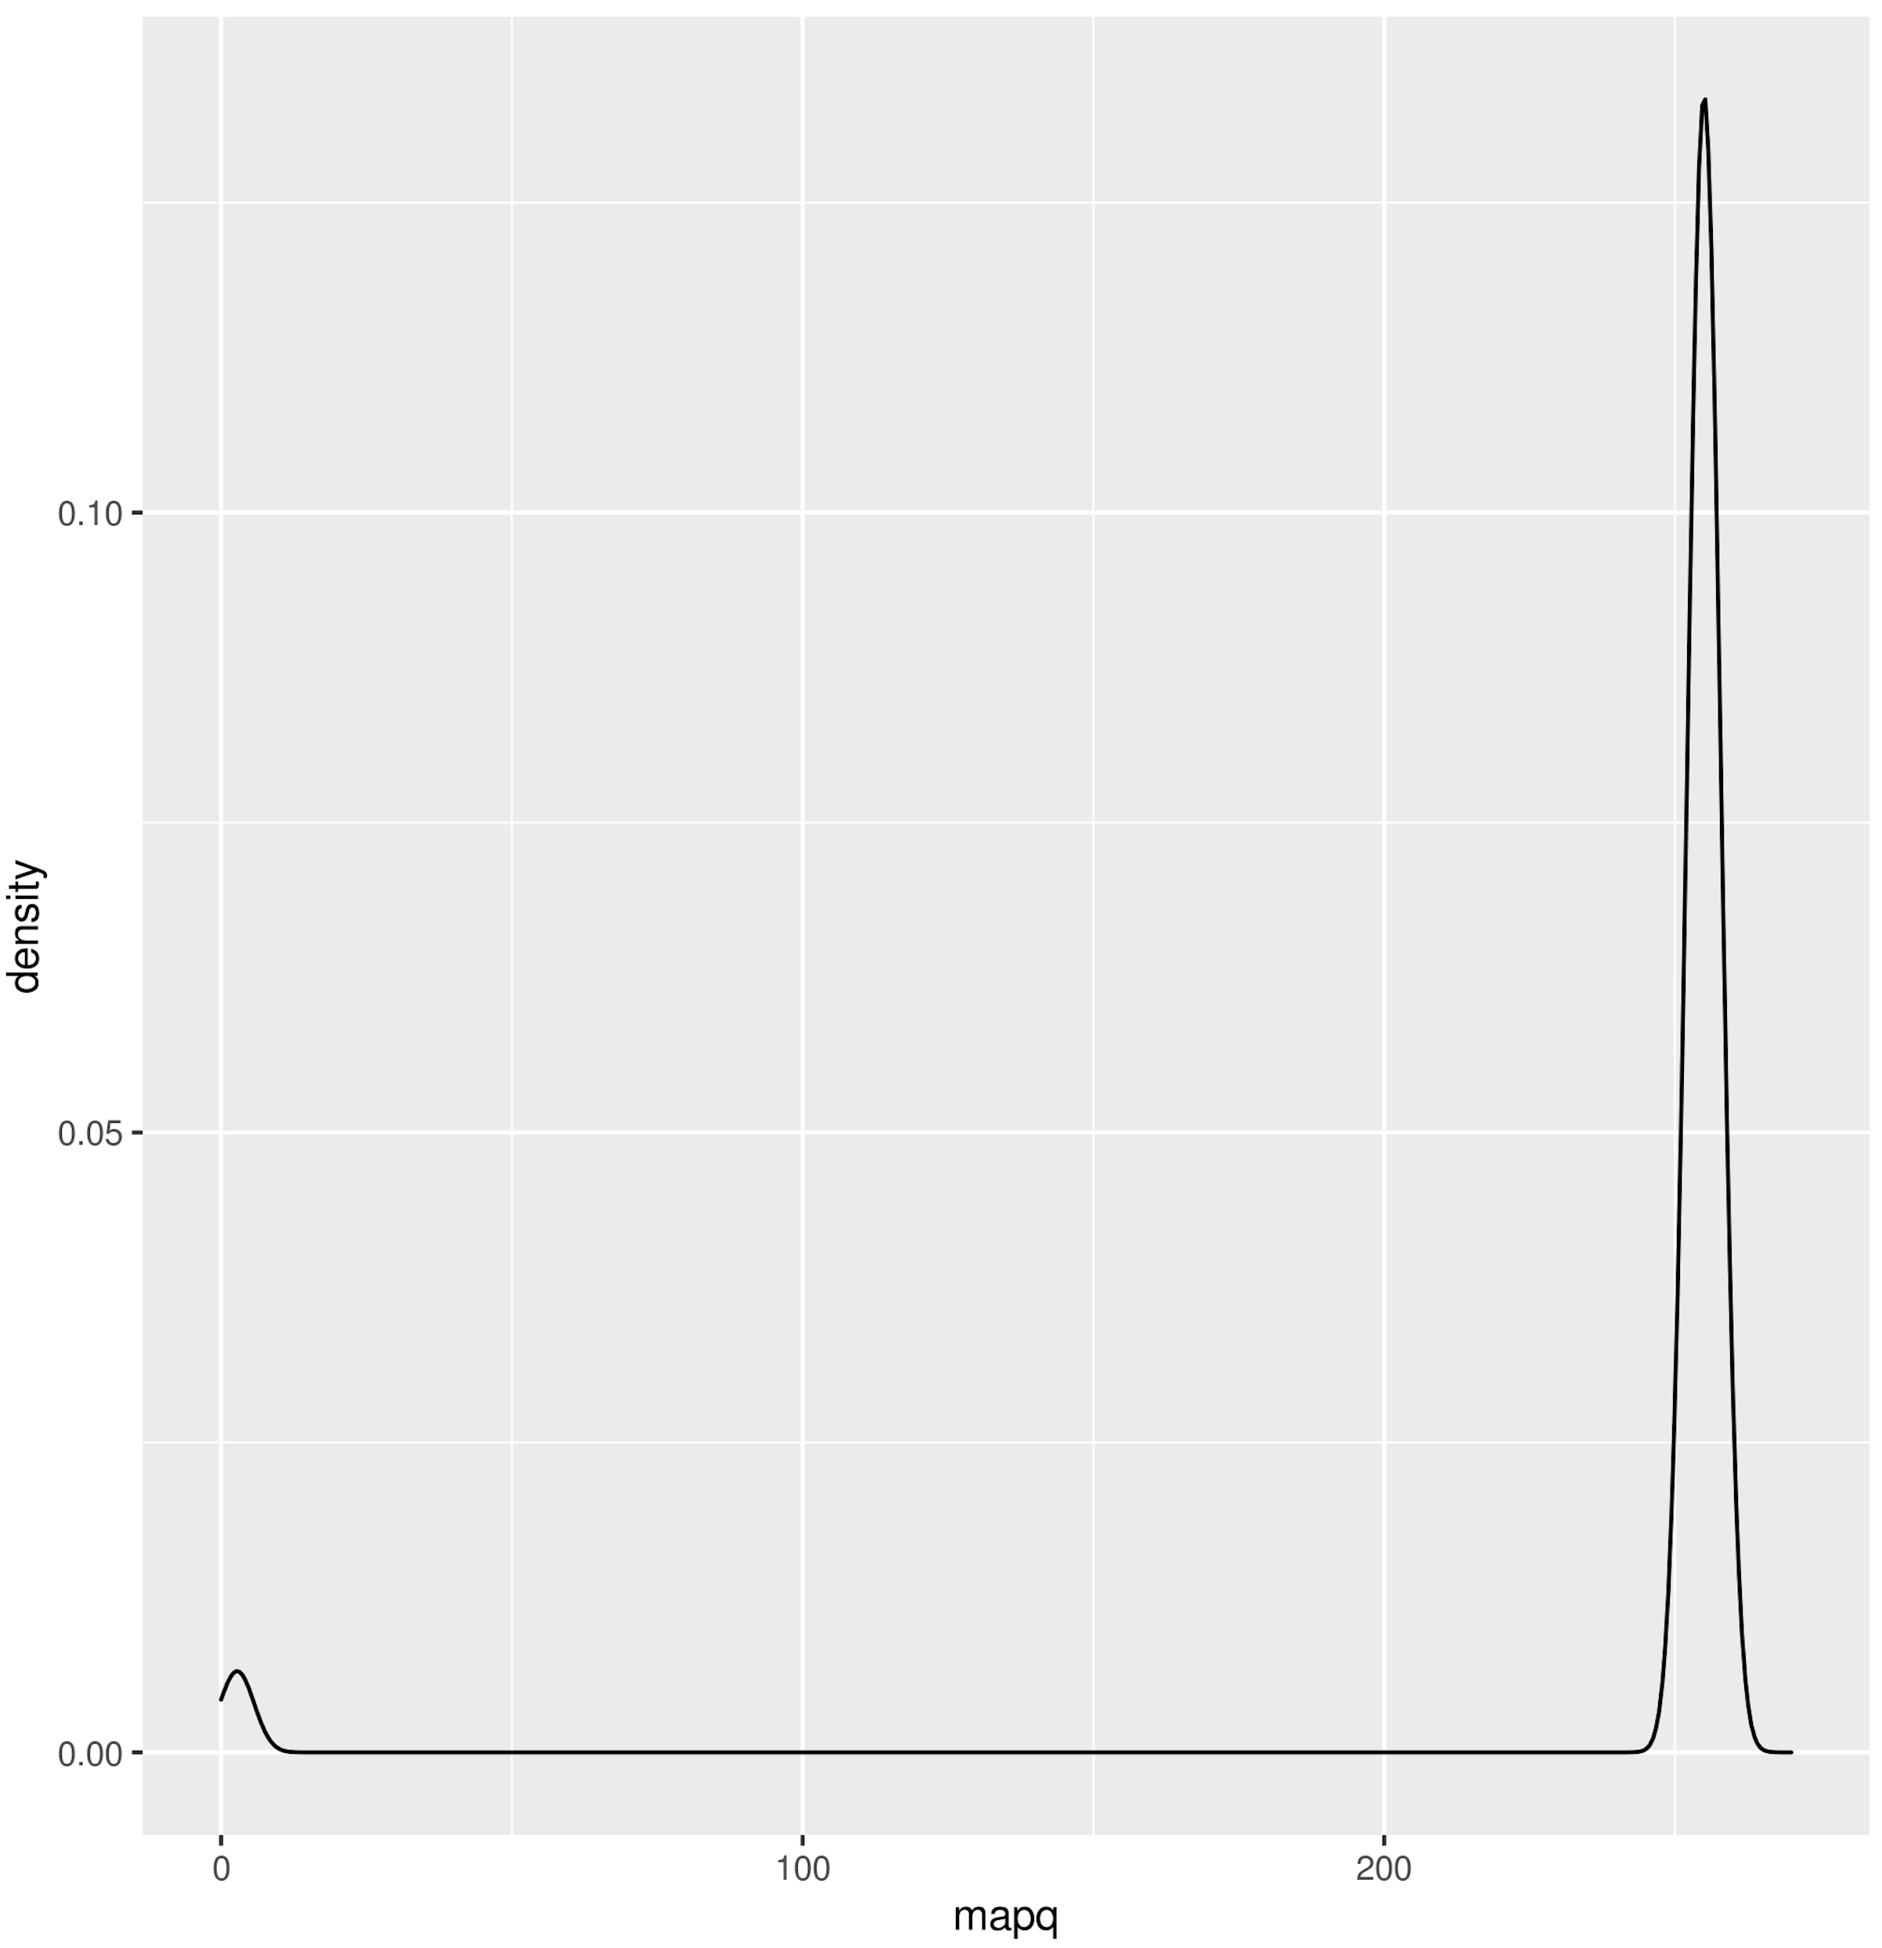
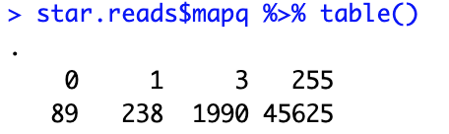
STAR mapq
Encode RNA-seq alignment pipeline parameters
Filtered for primary alignments only
The code that generated the original alignment:
Github/star_mapq/encode_se_pe_star.sh
Original alignment output:
/scratch/fanc/hmtp/scAR/bulk/RNA/star_aligned/Lin_neg_RNA_GSM002003_SRR002003_fastp/Lin_neg_RNA_GSM002003_SRR002003_fastp_star_genome.bam
This example is taking the NKC region only (chr6:128534000-131409000)
The code that generated this figure:
Github/star_mapq.R

Slide 19
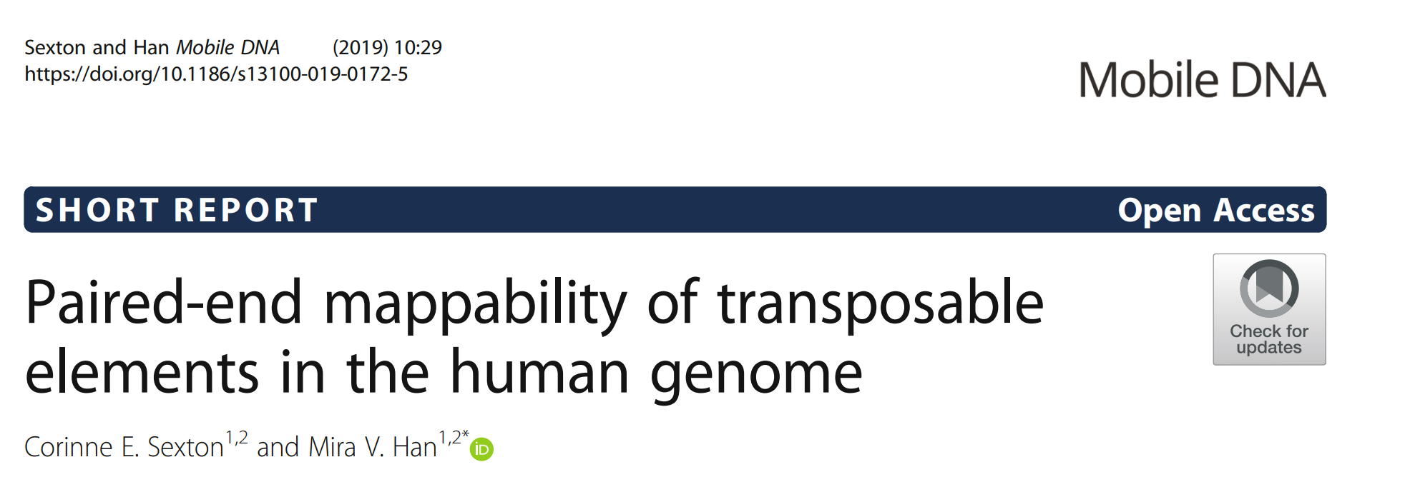
Does pair-end mapping solve mappability?
“﻿88% of all transposable elements in the RepeatMasker database are uniquely mappable”

Slide 20
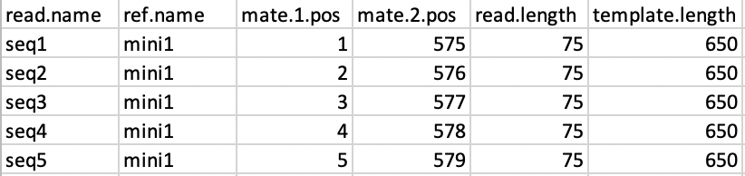
How is pair-end information helping mapping?
500 bp
1M bp
A
B
Spacer
A
C
Should be 649

Slide 21
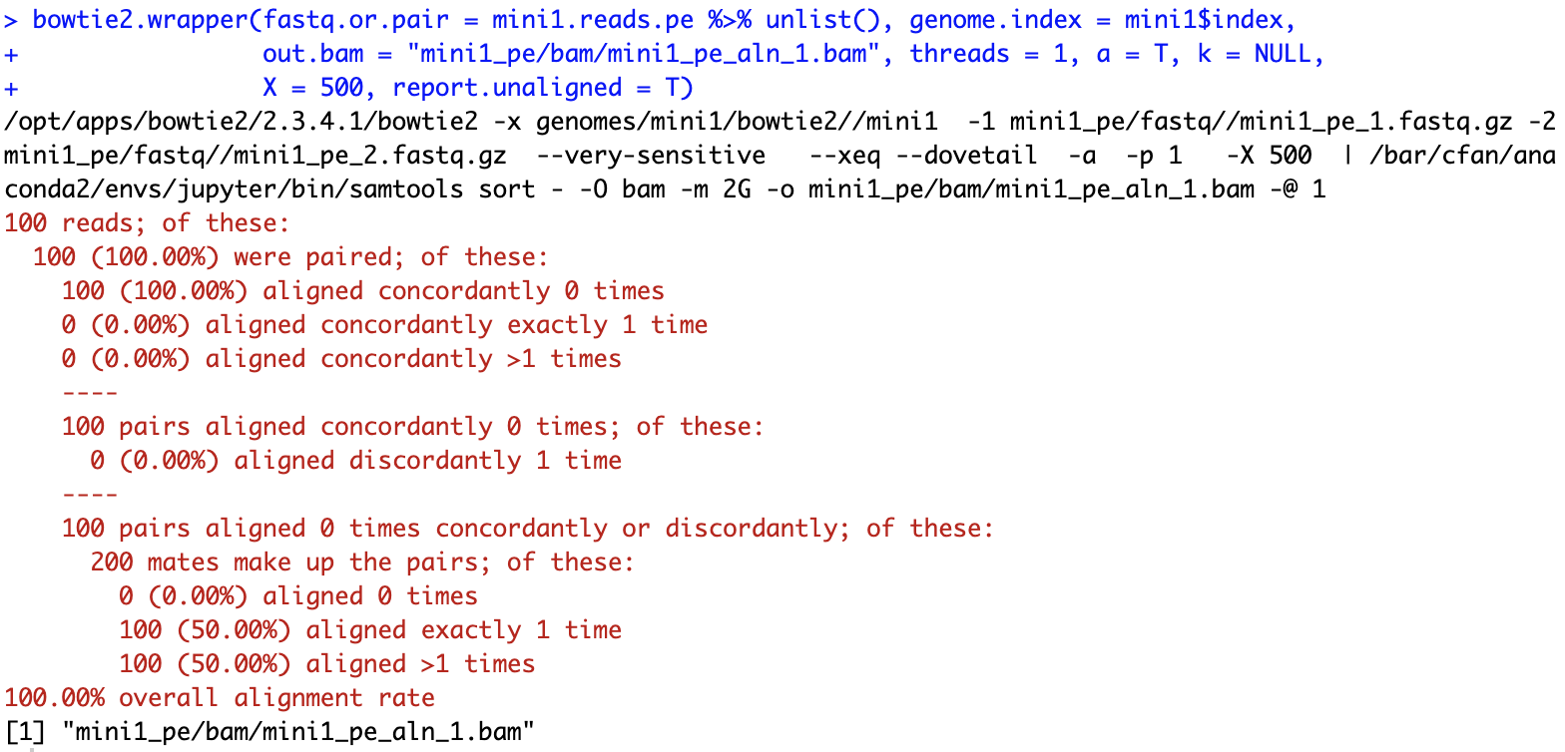
Alignment using bowtie2

Slide 22
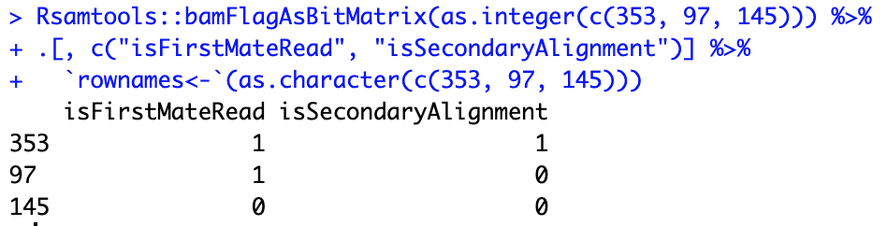
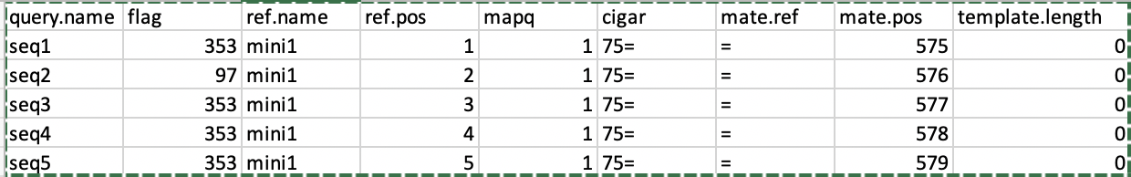
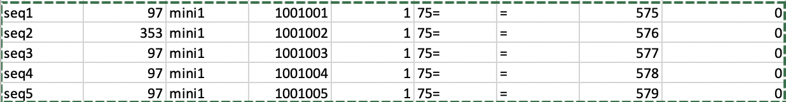
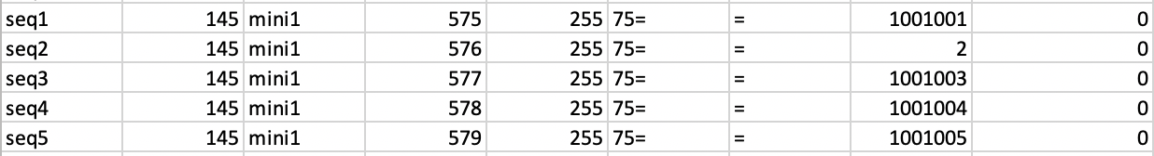
reads
Should be 649
alignments
353: secondary
97: primary
mate1
mate2

Slide 23
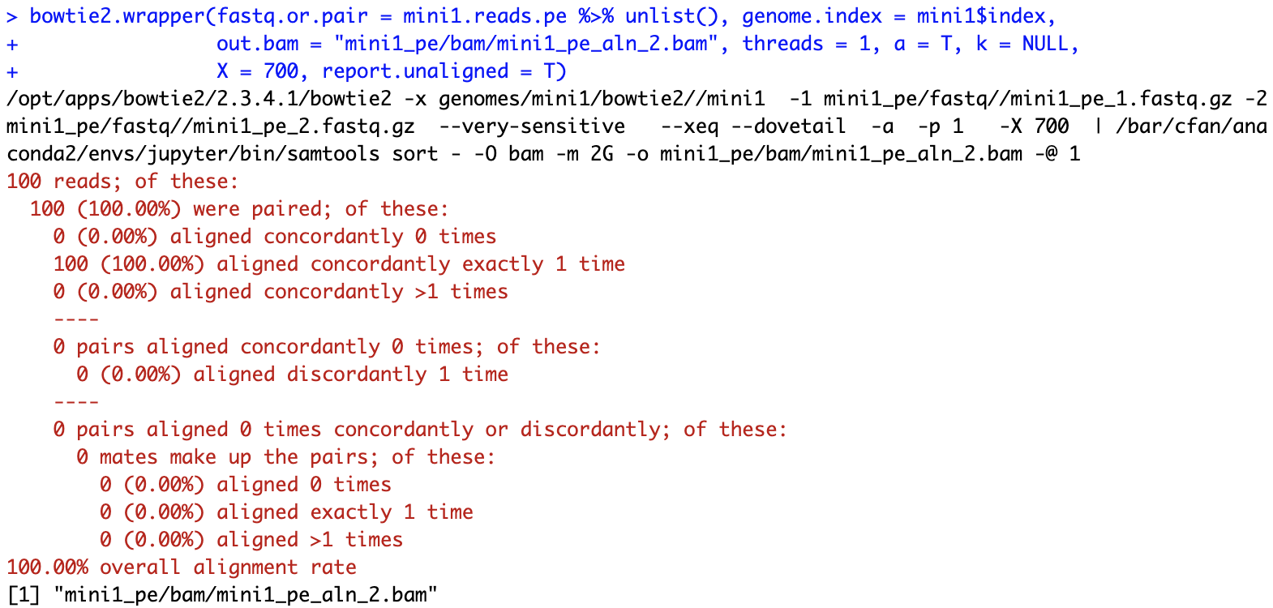
A small adjustment that saves the game:

Slide 24
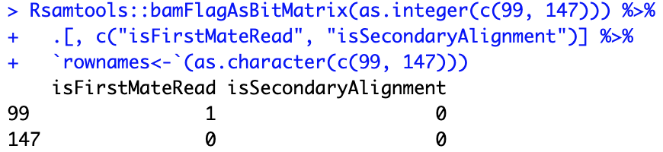
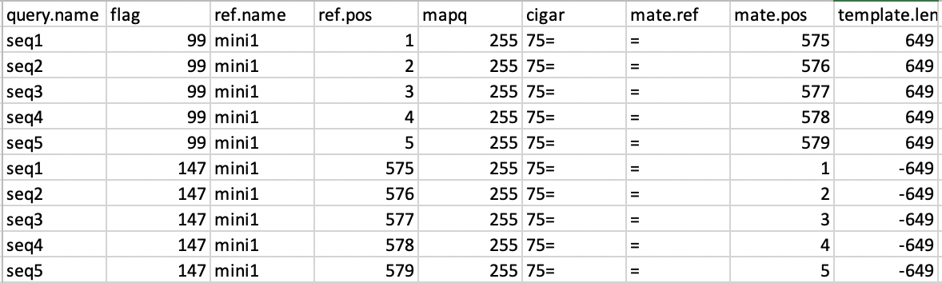

Slide 25
Bowtie2 algorithm for pair-end mapping
First try to map a pair concordantly
On the same chromosome; distance < “-X”
For reads that cannot be mapped concordantly, try to map them discordantly
2 mates are mapped independently

Slide 26
The magic “-X” in the real world
Data contributed by Jess

Slide 27
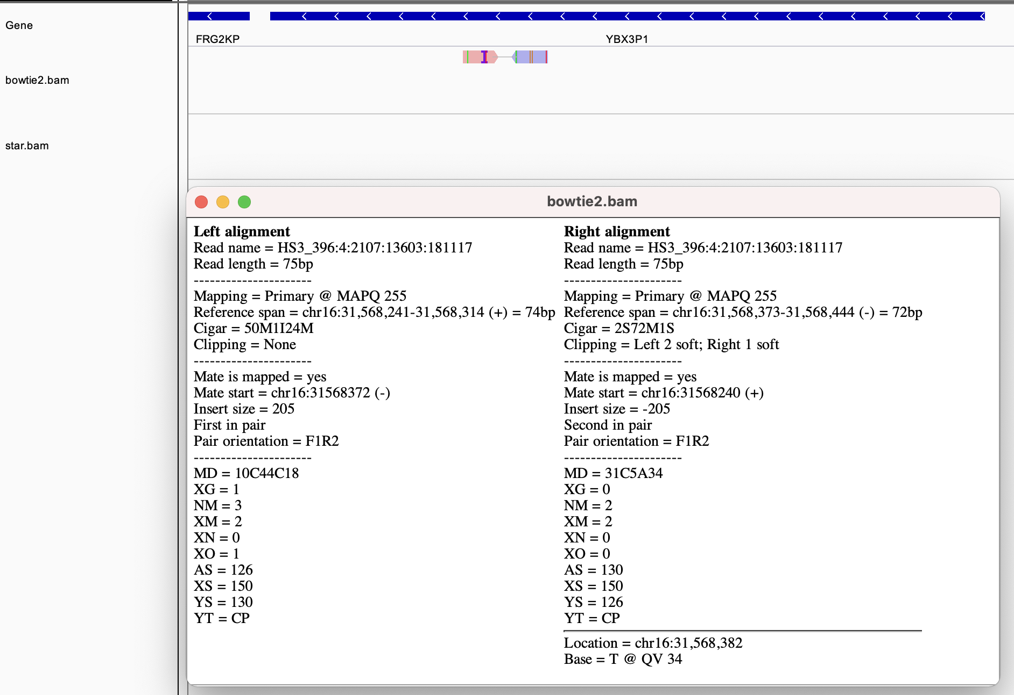

Slide 28
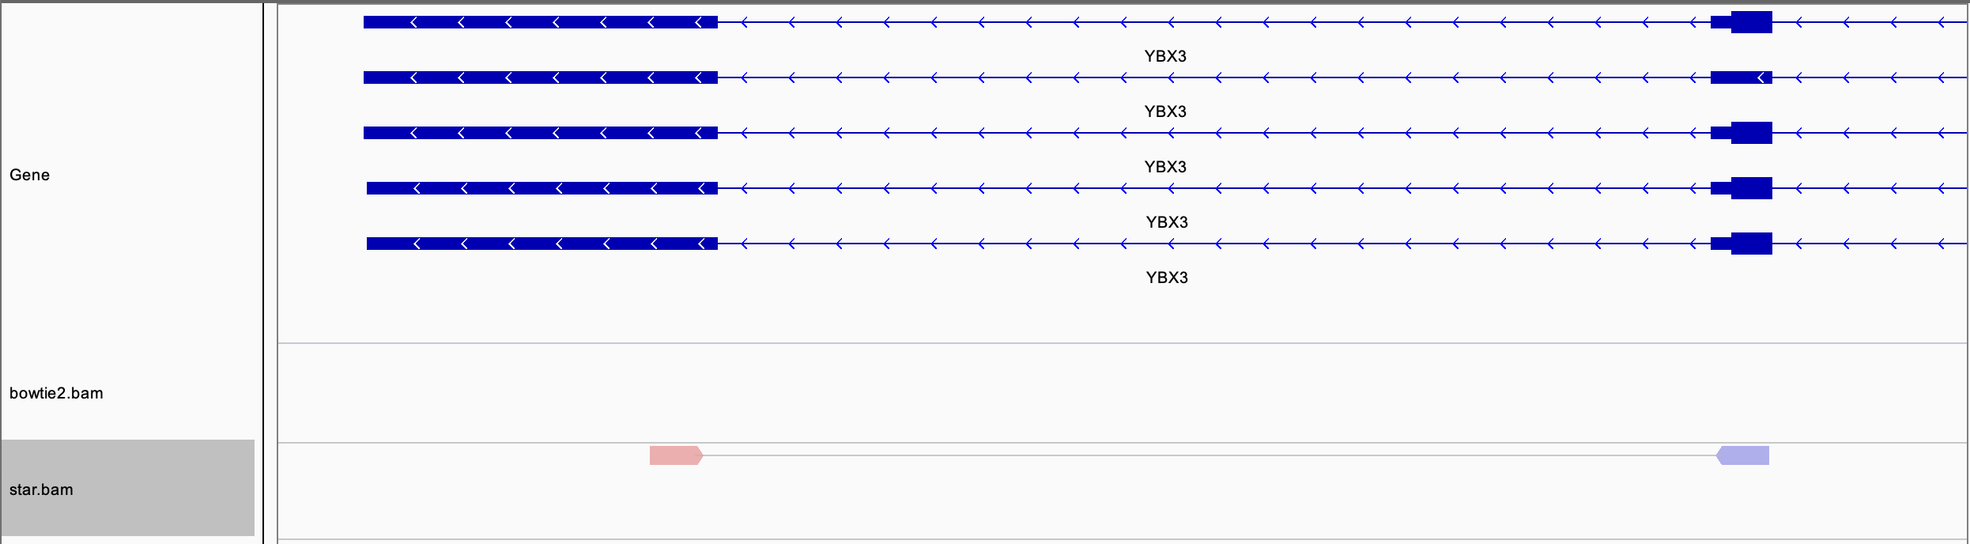

Slide 29
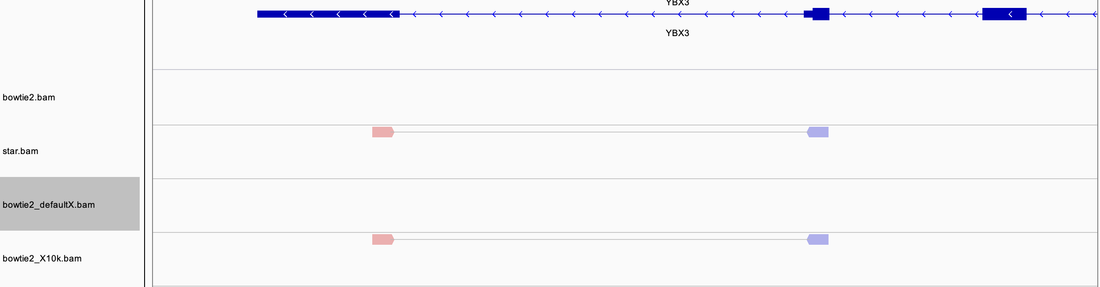
Default -X:
bowtie2 --mm -x /bar/cfan/genomes/hg38/bowtie2/hg38 -1 bowtie2.R1.fastq -2 bowtie2.R2.fastq | samtools sort - > bowtie2_defaultX.bam
custom -X 10000:
bowtie2 --mm -x /bar/cfan/genomes/hg38/bowtie2/hg38 -1 bowtie2.R1.fastq -2 bowtie2.R2.fastq -X 10000 | samtools sort - > bowtie2_X10k.bam

Slide 30
Lessons from this example
Bowtie2 shouldn’t be used for RNA-seq
We can increase –X to tolerate splicing, however
Bowtie2 becomes very slow as –X increases.
Certain introns can be huge.

Slide 31
Align the ATAC-seq data to Ly49 locus

Slide 32
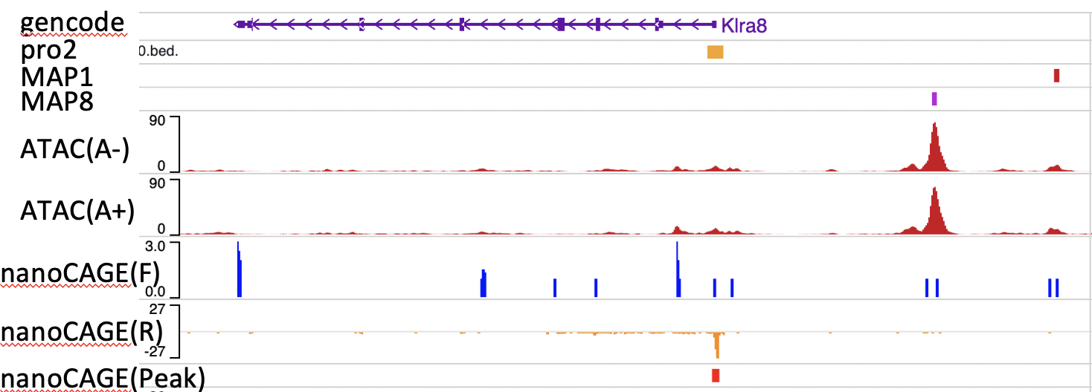
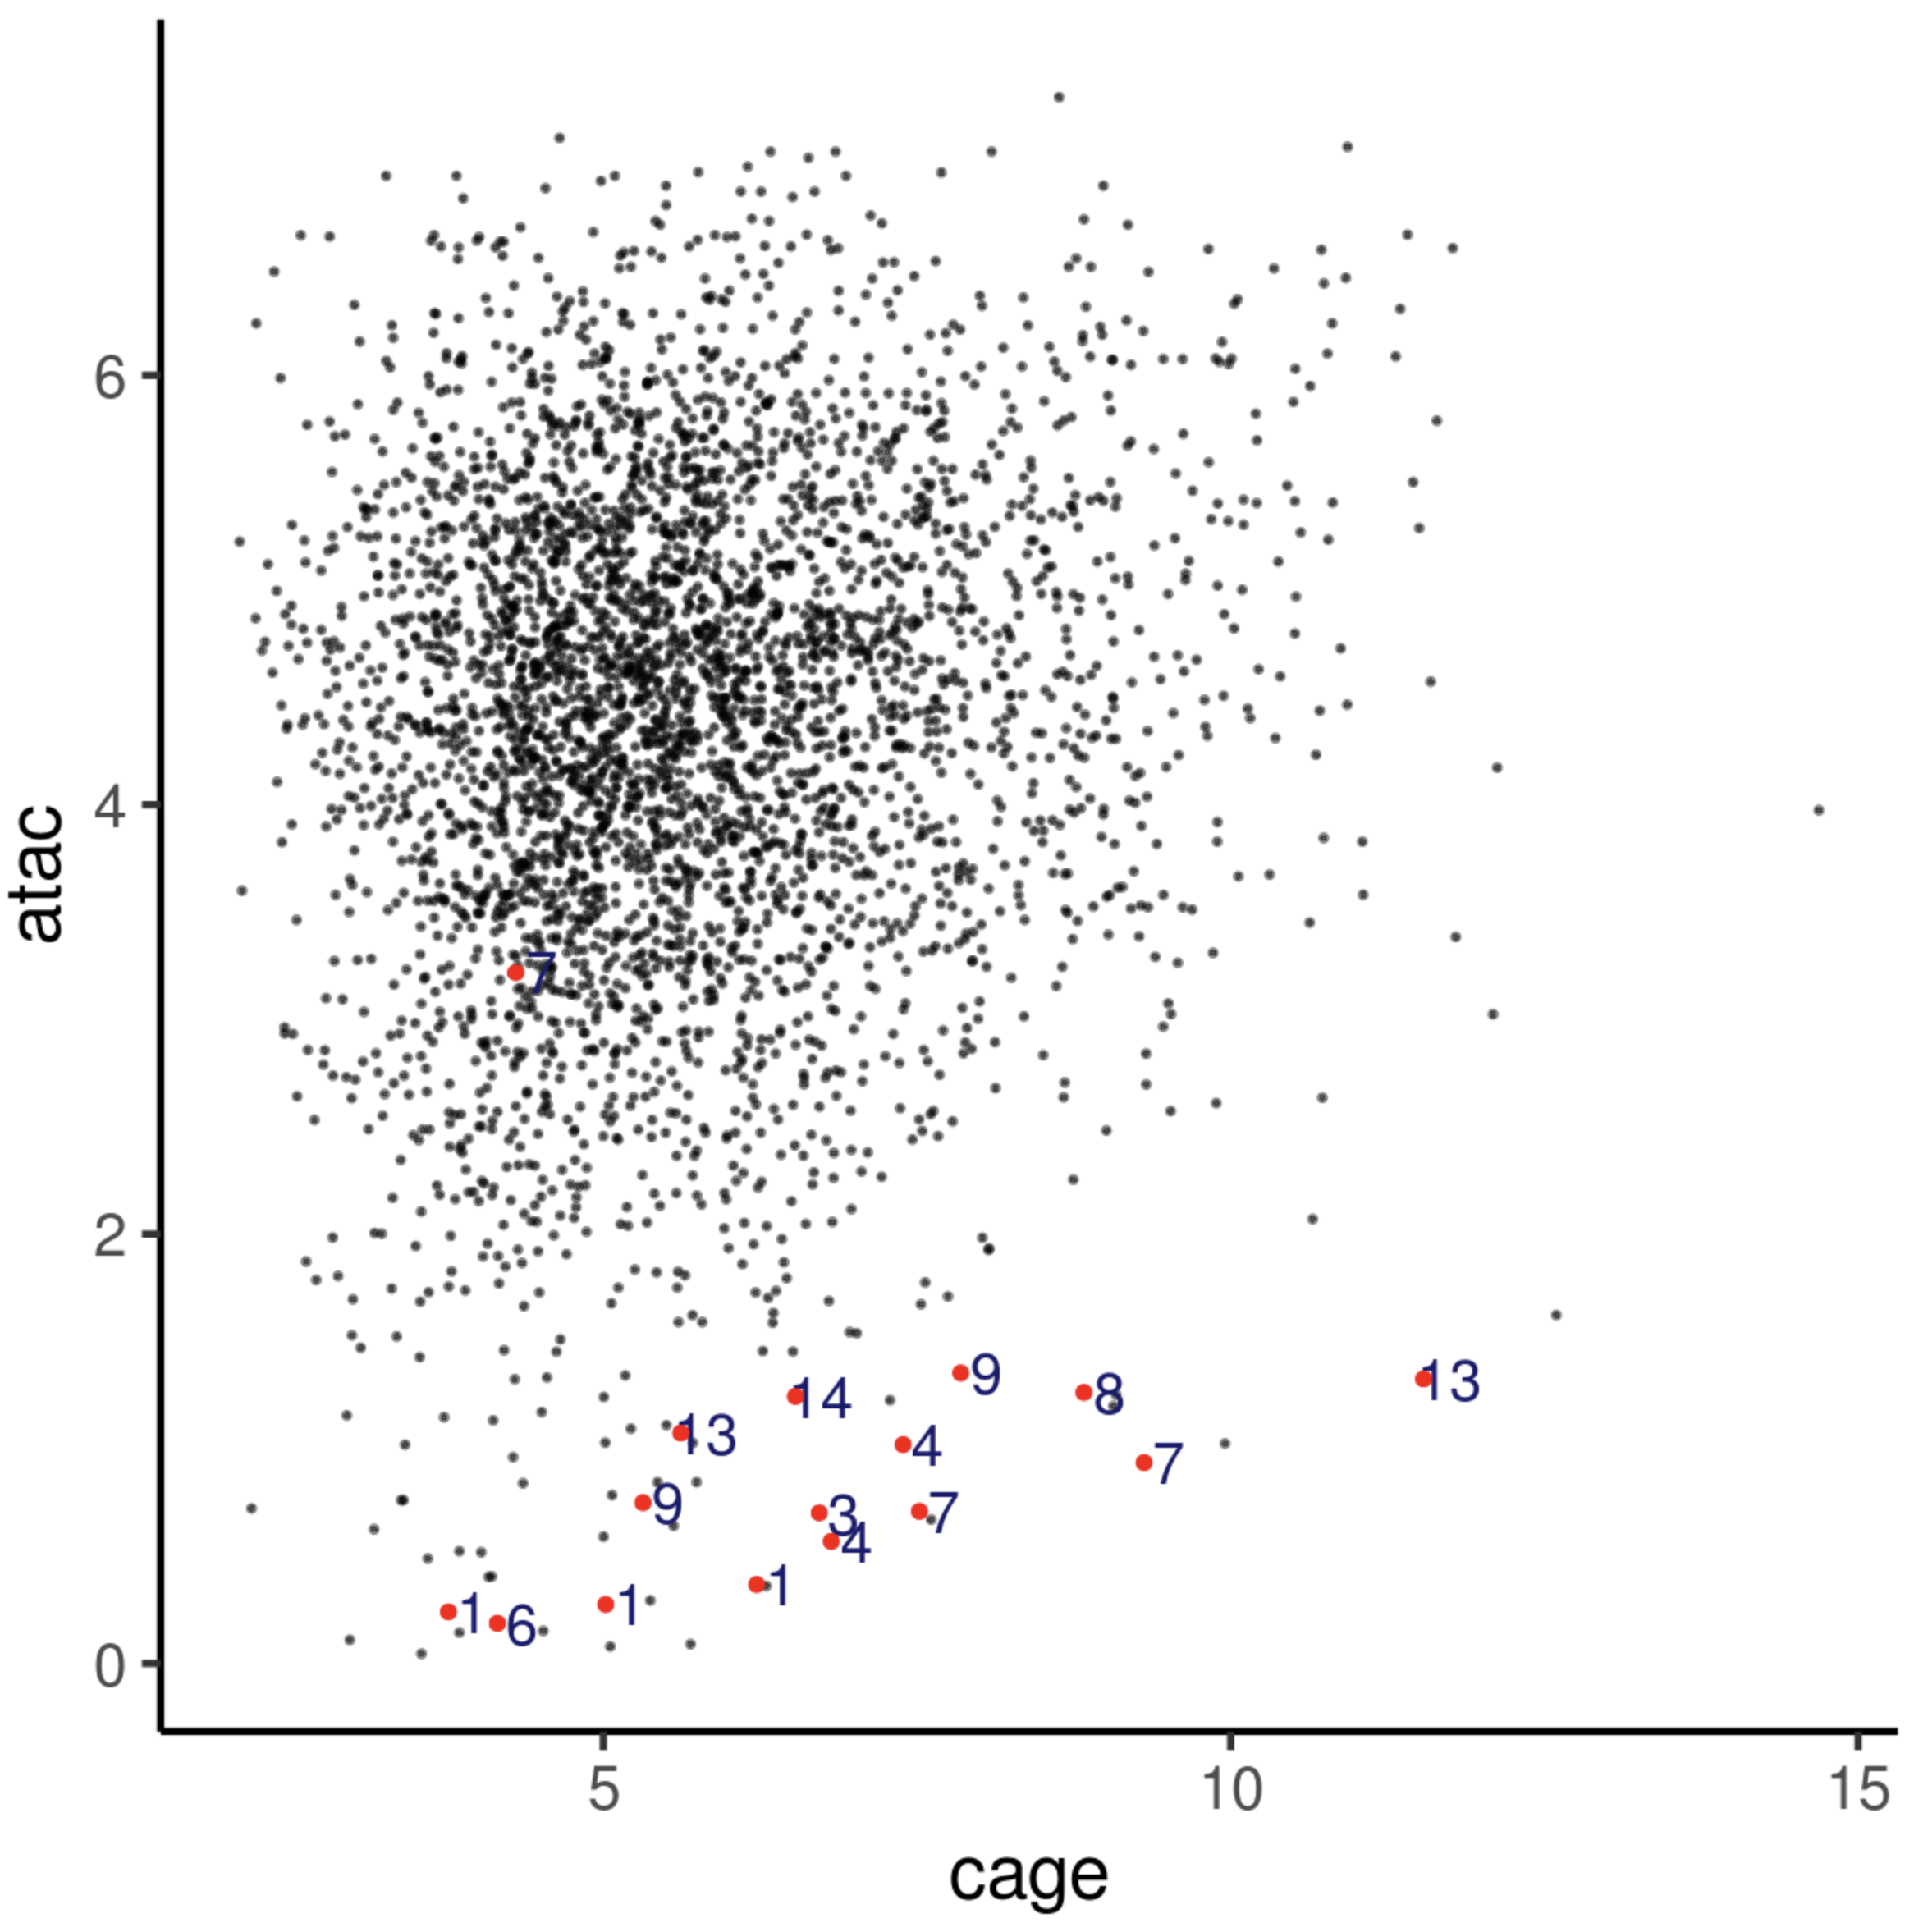
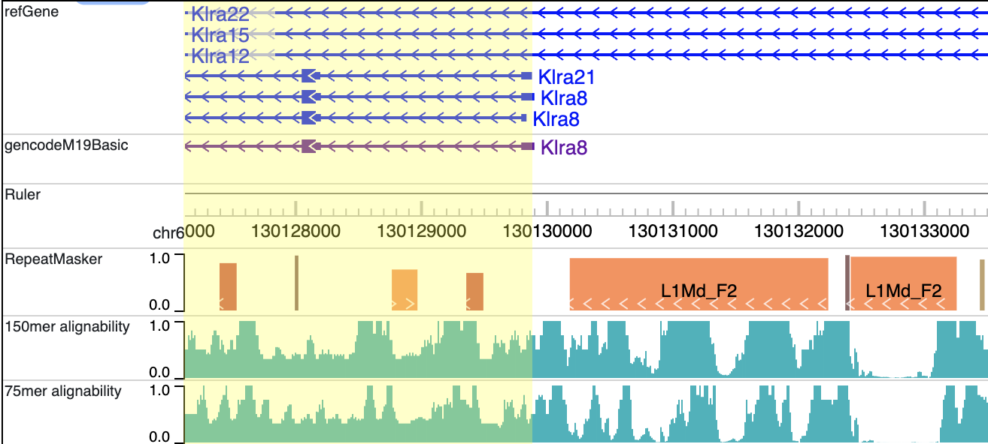
The Ly49 family: more than 10 orthologs
Could this have been caused by lower mappability at TSS?

Slide 33
The goal:
“Rescue” alignments in the Ly49/Klra TSS regions that might have been missed for their lower mappability
Try to maintain a reasonable specificity
Set up a reasonable upper bound for the number of reads that can be aligned to these regions

Slide 34
Challenges in aligning reads at the Ly49 locus
Define:
“real alignment”: genomic position where the DNA fragment is actually from
The task of the aligner is to find and report the real alignment.
Sensitivity:
The real alignment must be among the alignments found by the aligner
Specificity:
The aligner has to choose the real alignment as the primary alignment and give it a reasonable MAPQ

Slide 35
Sensitivity issues:
Issue: from bowtie2 manual, it’s unclear how this is implemented
-k 5: bowtie2 will look for 5 alignments.
Issue: aligning 1M read to the human genome would take FOREVER

Slide 36
Specificity issues
If region A and region B are different by 1 bp.
MAPQ will be low

Slide 37
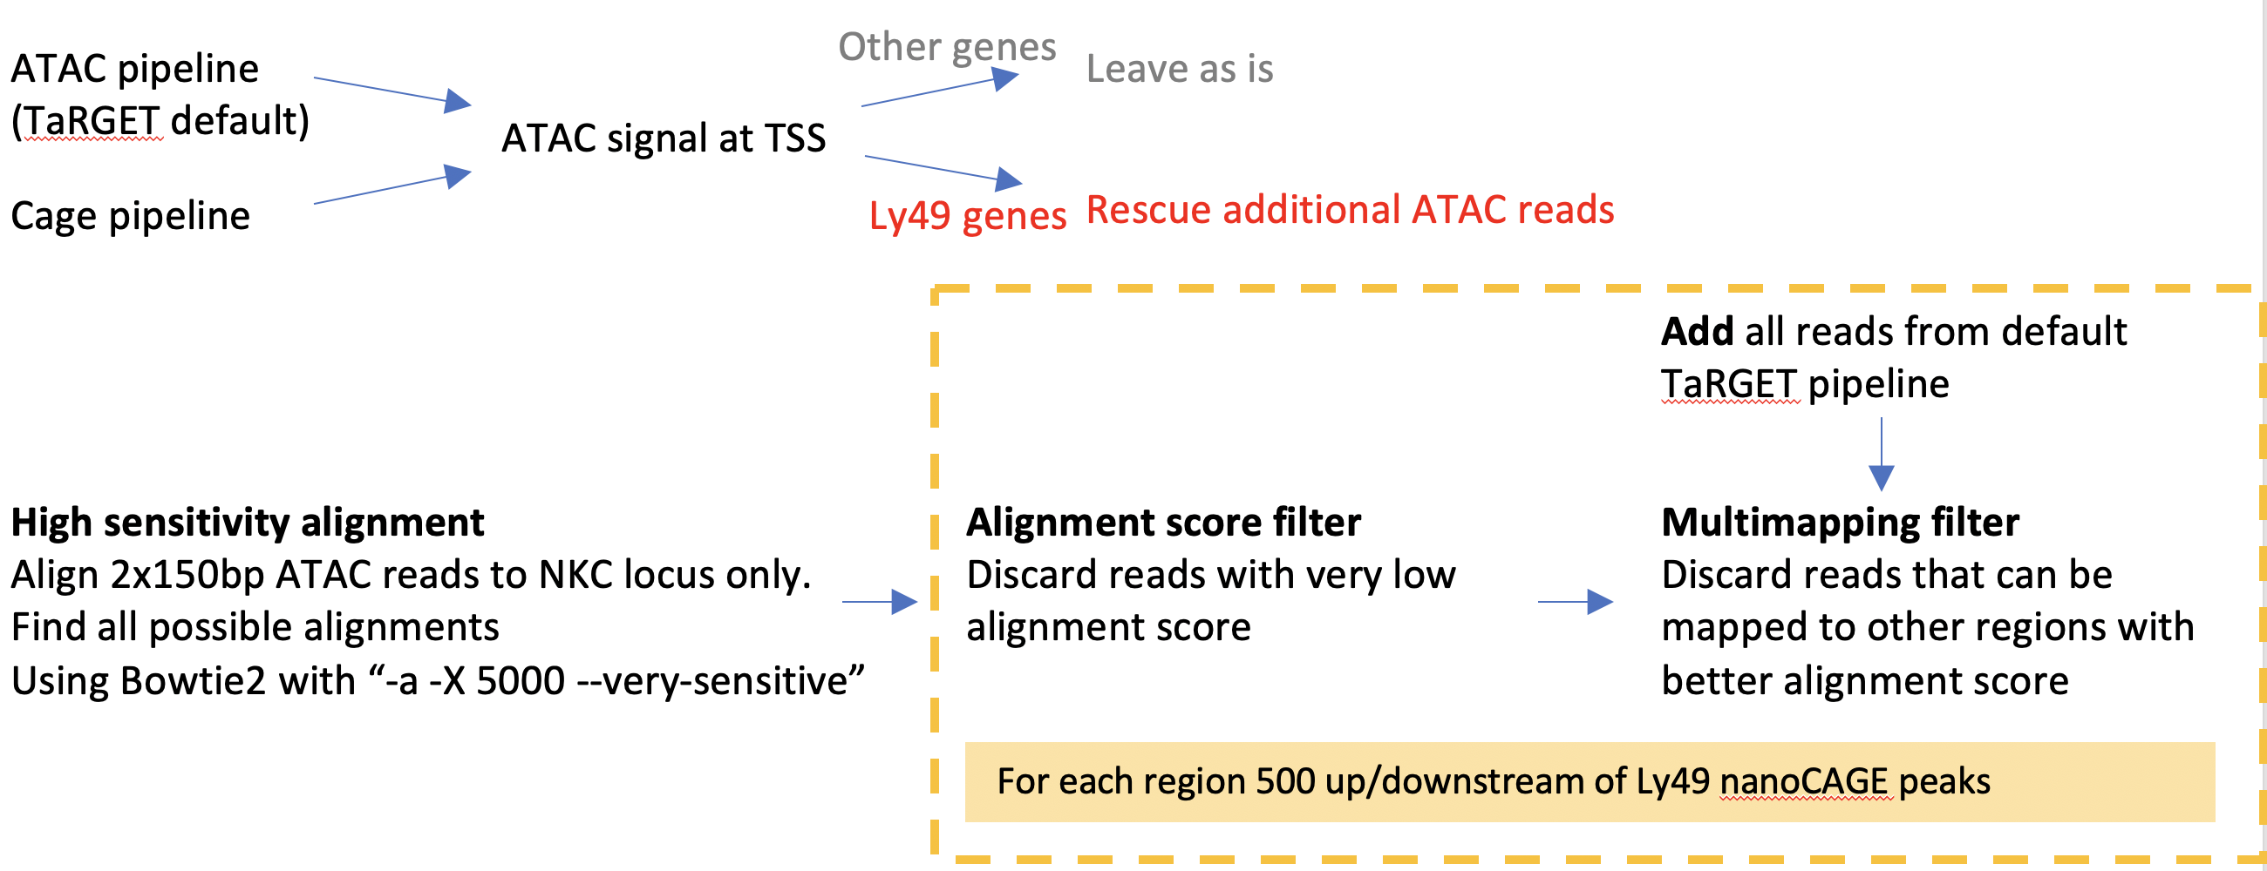
Script: /bar/cfan/4dn/nk/mappability/nkc_bowtie2/nkc_bowtie2_2021-04-27.R
Script: /bar/cfan/4dn/nk/cage/nk/peak_cor/mapq_rescue_2021-05-02.R
It calls function sync.o.rescue, which is coded in: /bar/cfan/R_packages/cageFanc/R/sync_cage_to_dna_assays_legacy.R

Slide 38
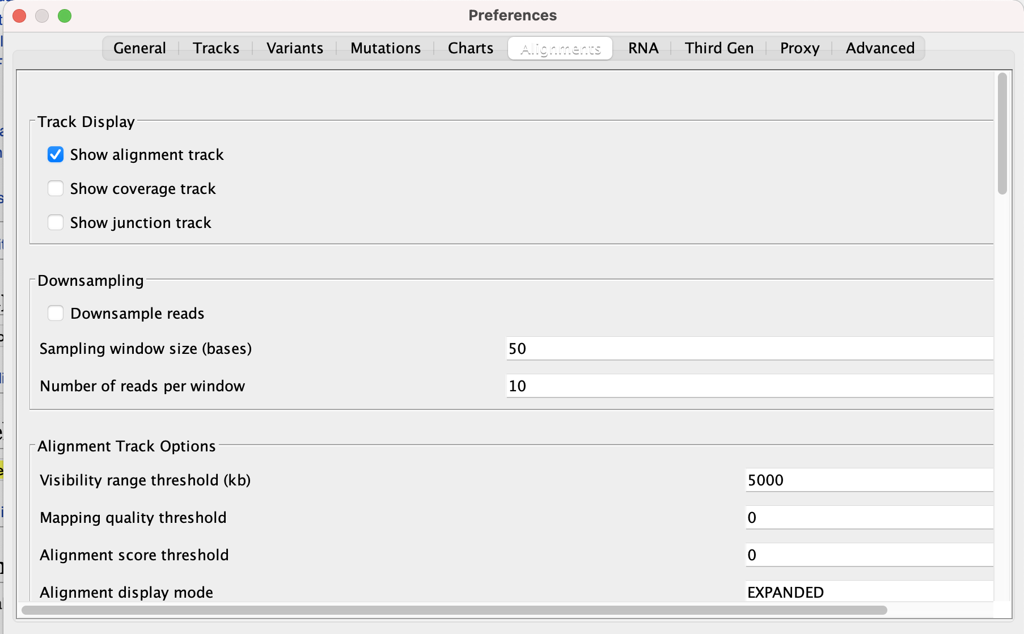
Be careful about IGV settings:

Slide 39
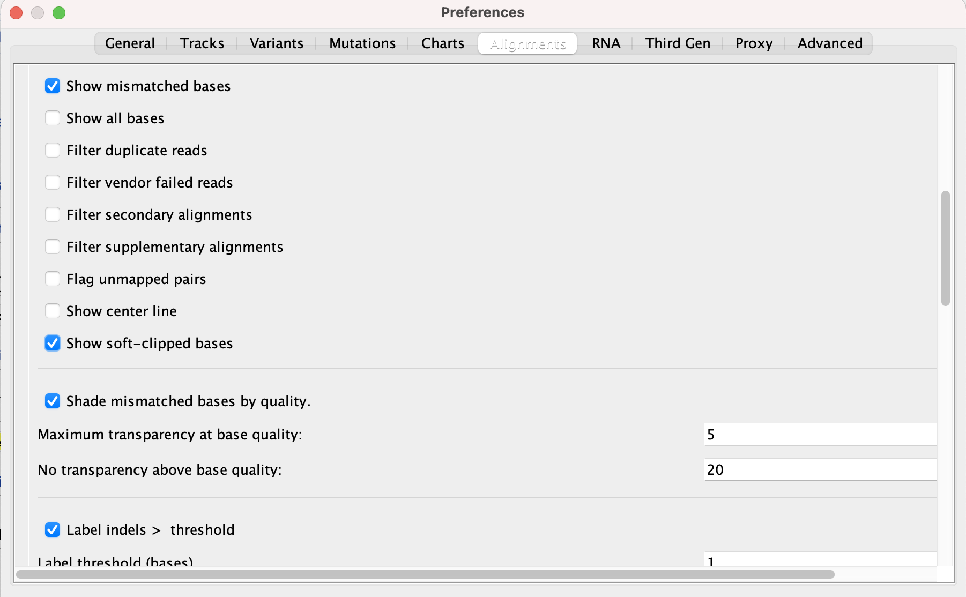

Slide 40
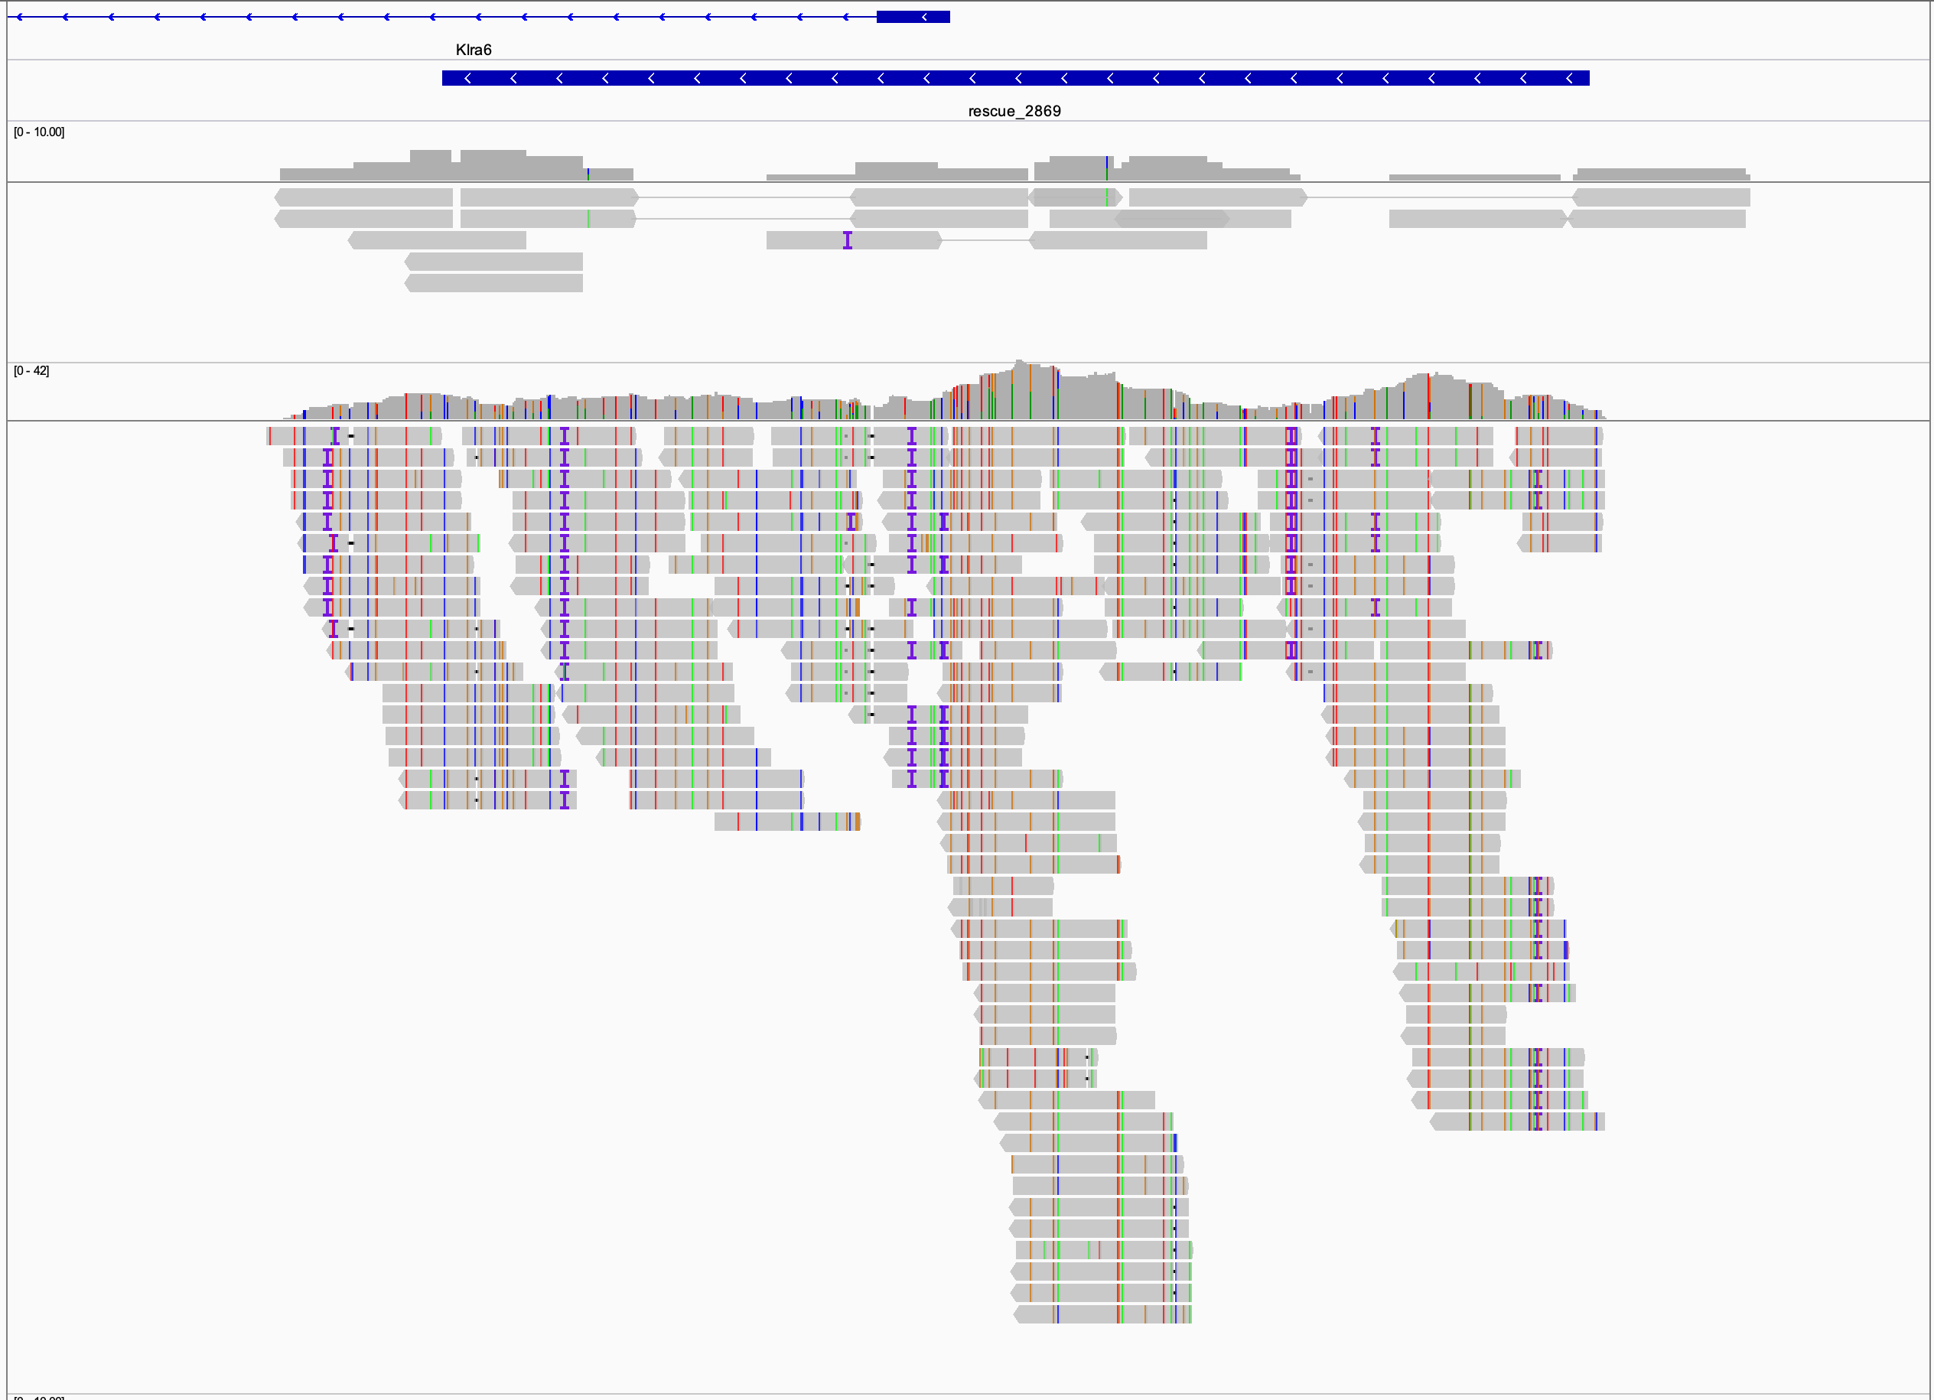
Pass filter
Fail filter

Slide 41
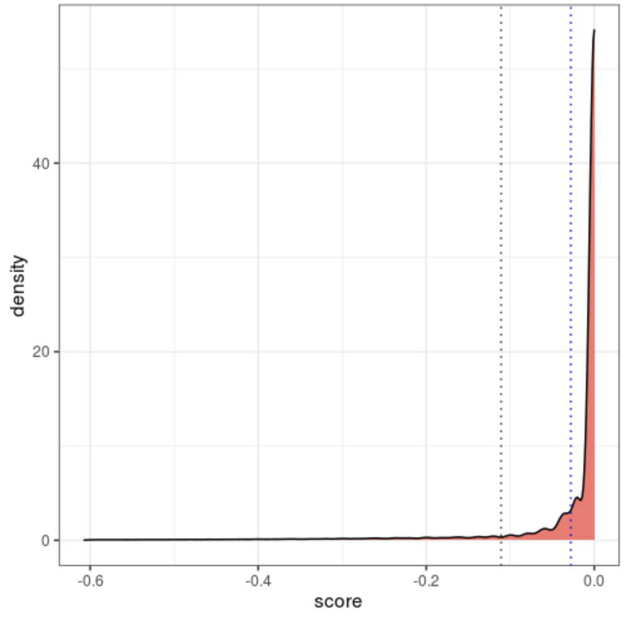
The price of maximizing sensitivity: a lot of poor alignments reported
Mean alignment score distribution
Calculated as AS/read_length
Calculated based on genome wide primary alignment (bowtie2 default reporting)
Blue: mean
Grey: mean - sd
Mean alignment score filter cutoff set at -0.1

Slide 42
Further filtering for alignments that passes the mean alignment score filter:
Keep all primary alignments
Some primary alignments are unique
Some other primary alignments might map to other regions equally good
For secondary alignments:
If mapq > 1, filter out (a unique best match exists, and it’s not this one)
If mapq == 1, keep (a unique best match doesn’t exists, I’m willing to count it)

Slide 43
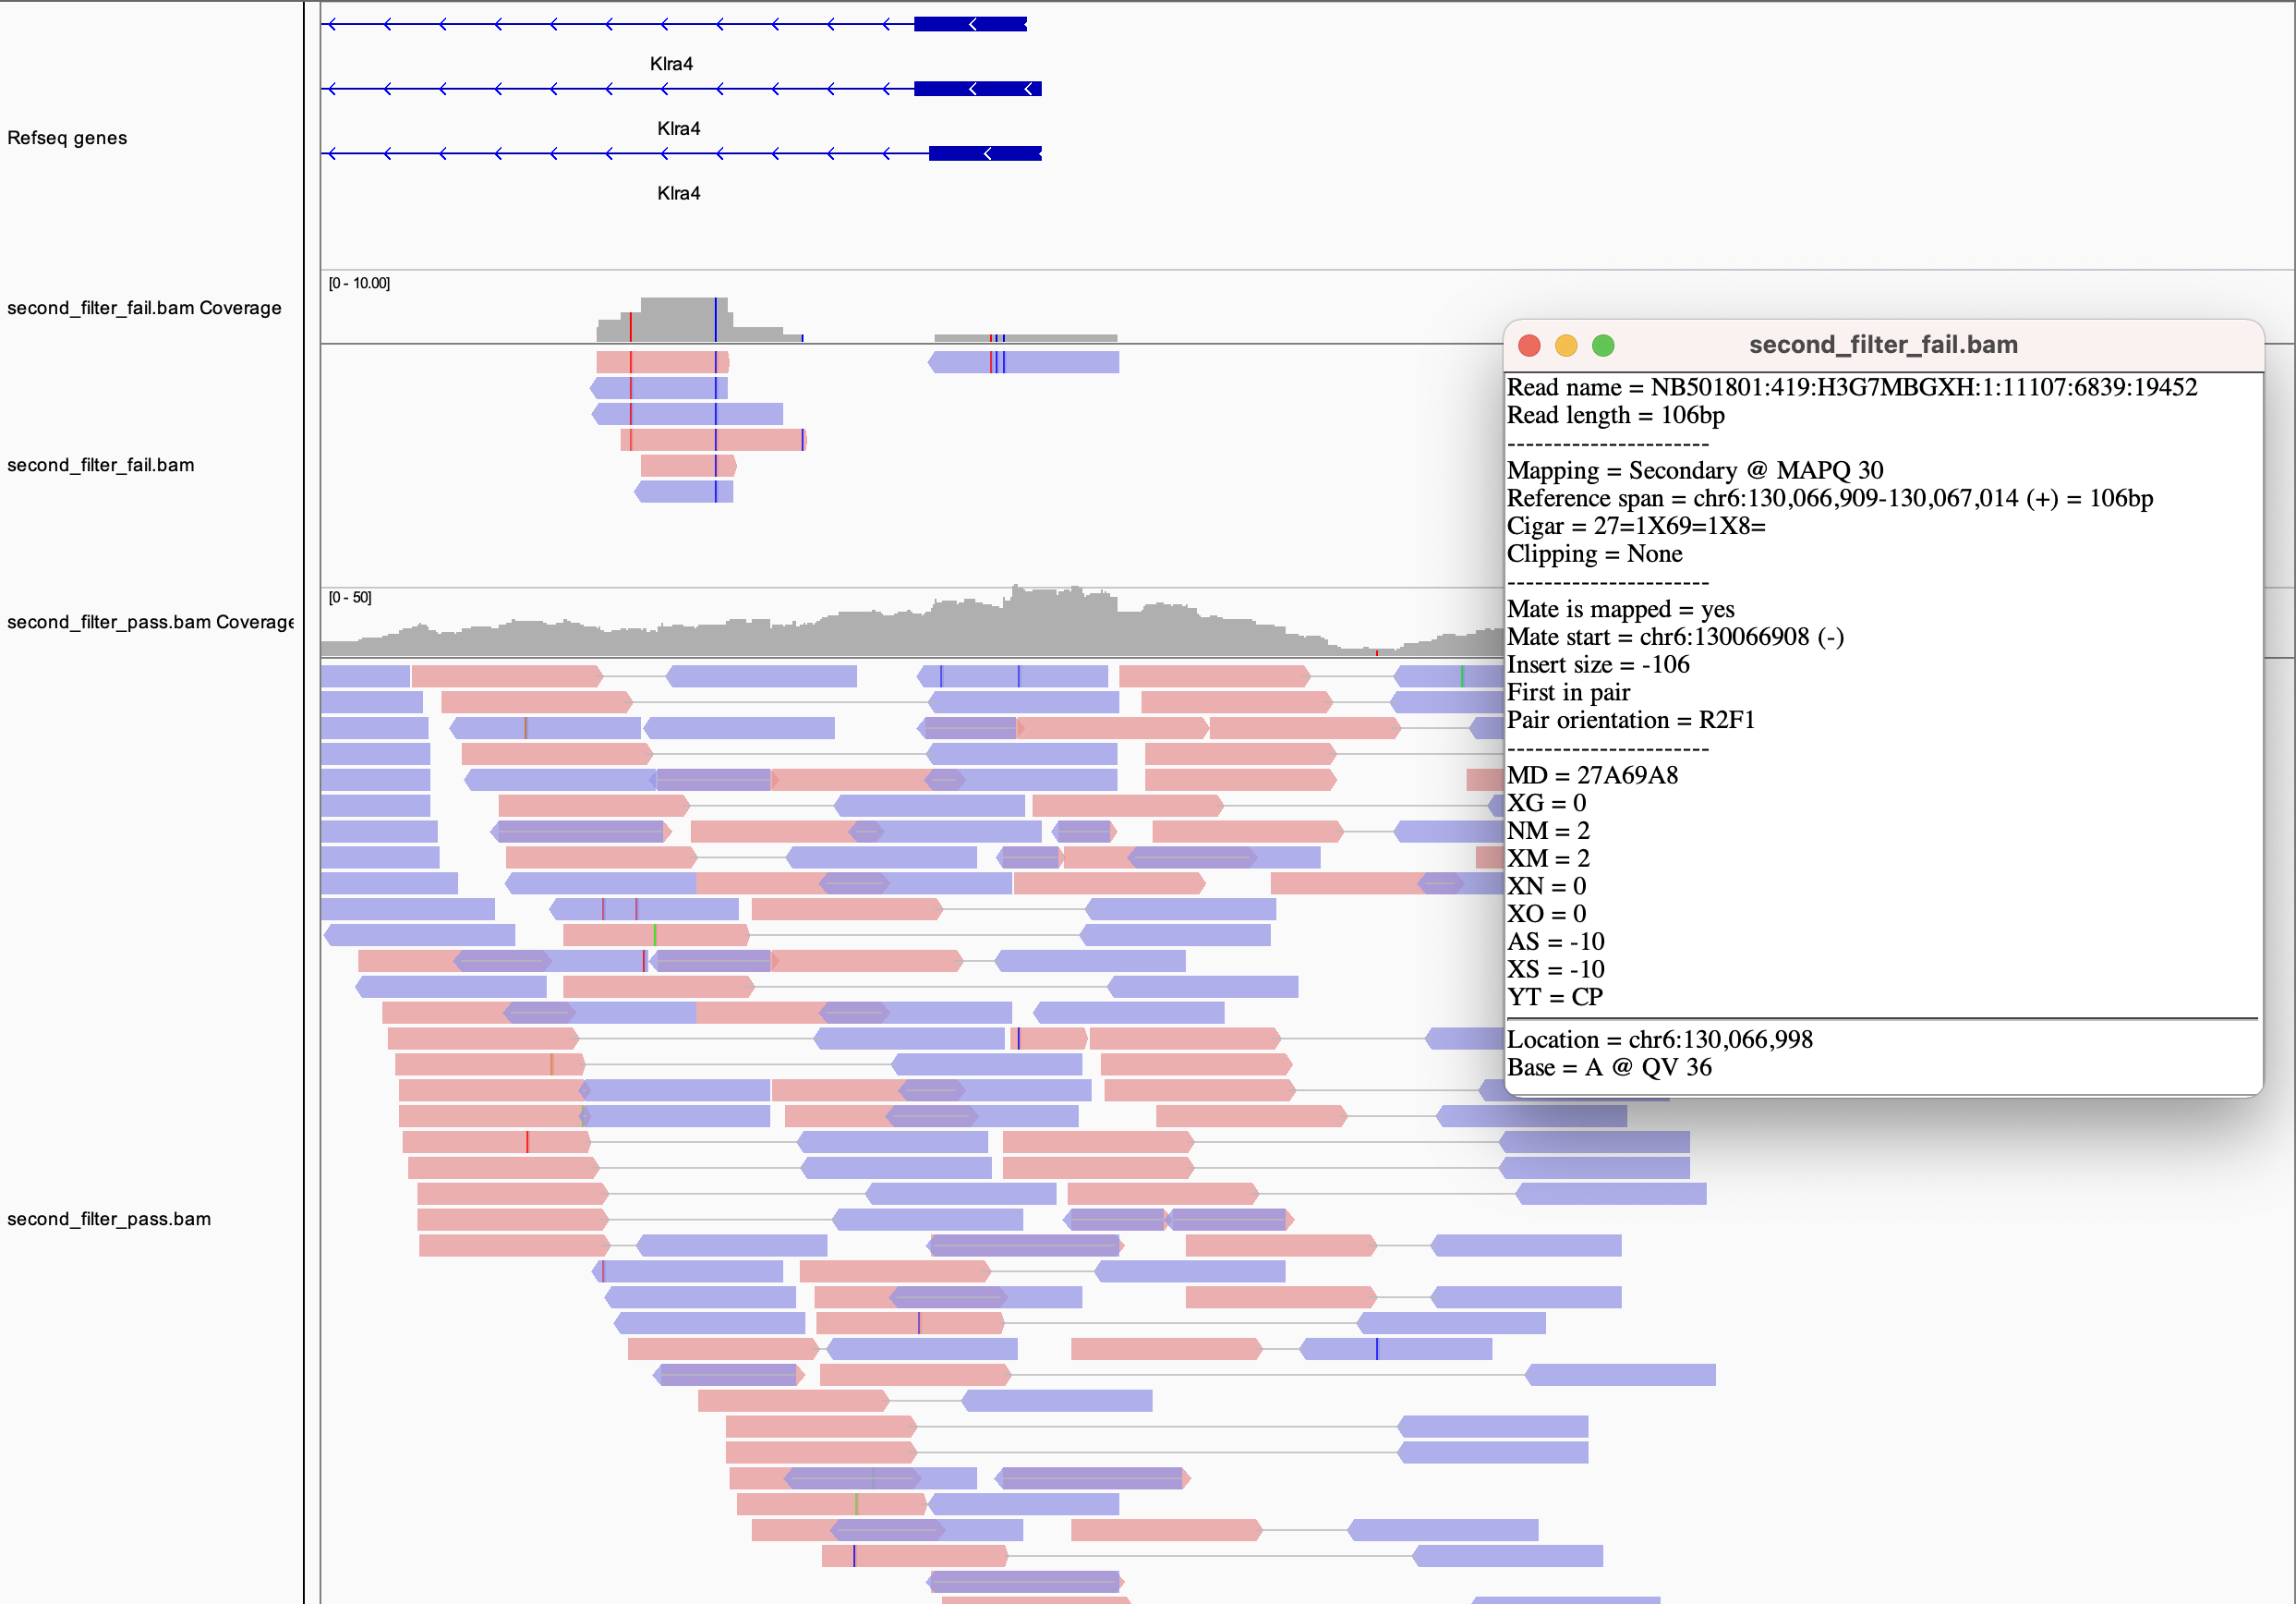
Fail filter
Pass filter

Slide 44
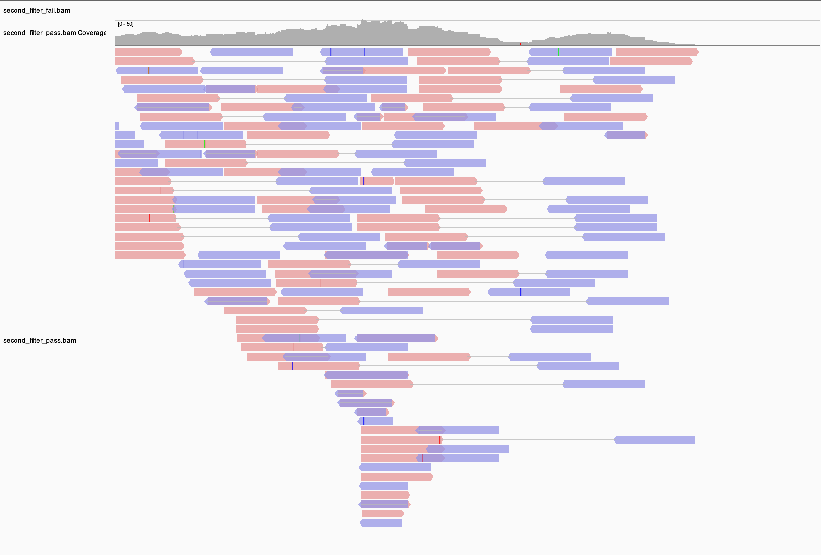
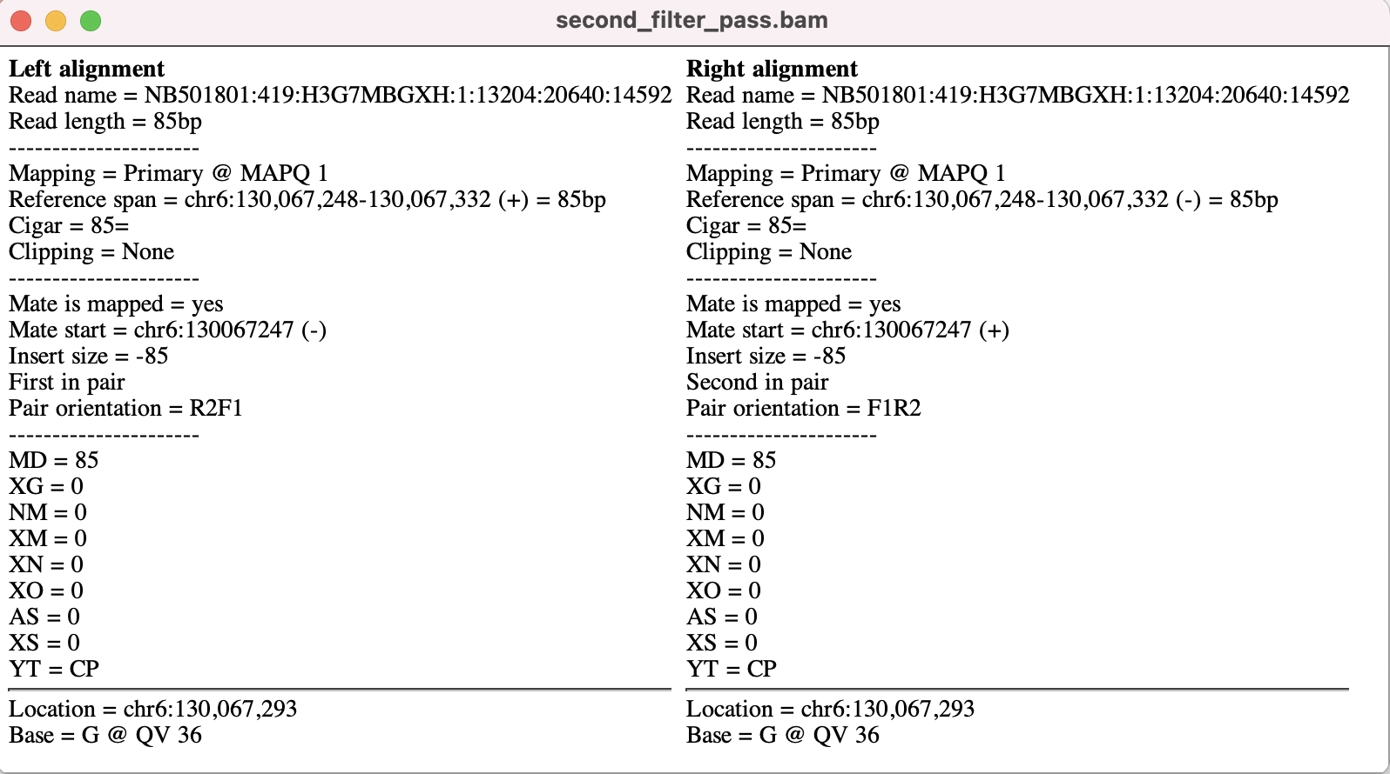

Slide 45
Assumptions of this approach:
The reference genome is high quality and covers all Klra genes
Suppose there is another Klra gene (call it Klra999) in C57BL/6J genome but not represented in the mm10 assembly, reads from Klra999 would have been assigned to the closest relative
Assumption: the genome of the sample is haploid, and exactly matches the reference
This is a reasonable assumption for C57BL6/J based research.
For human, however, the primary alignment could also have a number of mismatches due to sequence variation

Slide 46
Other considerations
How are unaligned reads handled?
Are they kept or are they filtered
How are mismatches coded?
Hint: in CIGAR and in tags
Note: by default, matches and mismatches are encoded the same in CIGAR. In bowtie2, this can be changed by specifying “-xeq” parameter.
The same tag can be defined differently by different tools

Slide 47
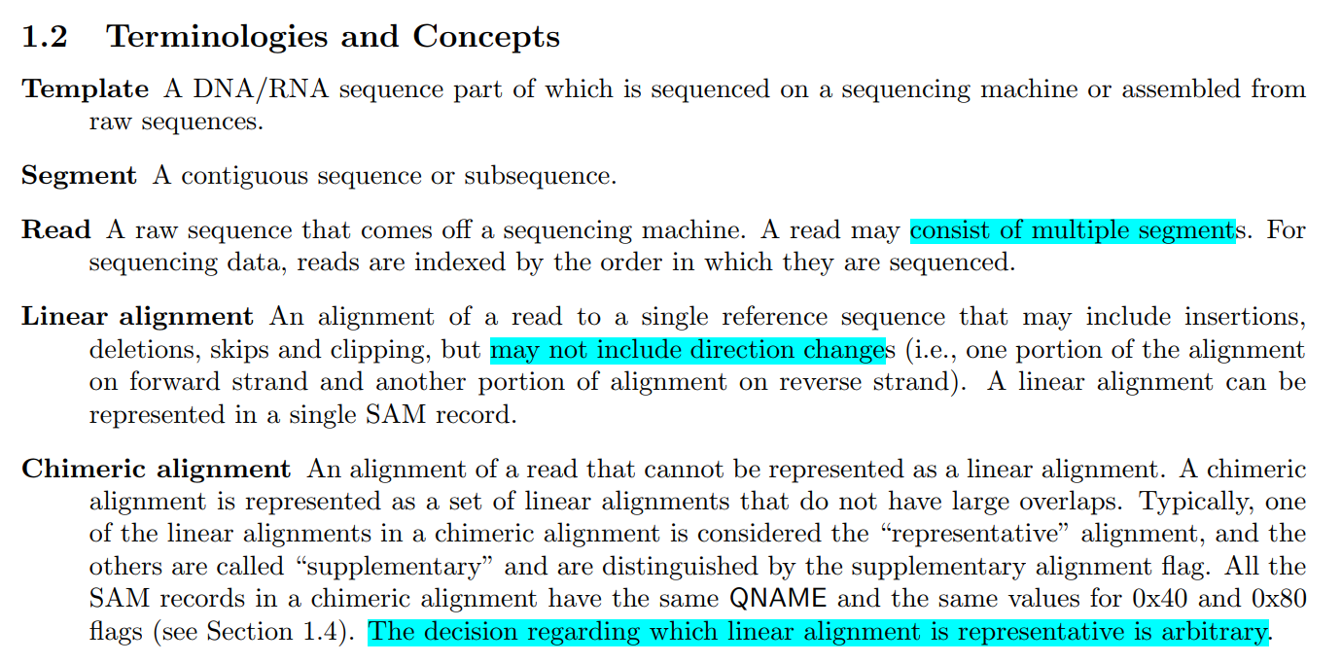
Mapping for HiC data: supplementary vs secondary alignments
multimapping
primary
secondary
Chimeric mapping
representative
supplementary

Slide 48
Dissecting the juicer alignment parameters
# cores
reference
read1
read2
output
Hi-C is single end mapping!!
chr1
chr2
A chimeric read
Theoretically:
Representative alignment
Supplementary alignment
In reality, juicer codes it this way:
Primary alignment
Secondary alignment

